Slide 1
Predicting Mortality from National Health survey data
Ben Johnson-Laird

Slide 2
Predictors
National Health and Nutrition Examination Survey (NHANES) (2013-2014)
Dependent Variable
Mortality (1 or 0) from NCHS Data Linked to NDI Mortality Files (2015)
Survey areas used
Demographic data (e.g. age, race, country of birth)
Laboratory data (e.g. complete blood count, cholesterol)
Questionnaire data (eg. alcohol use, smoking)
Respondents
6,100 participants
147 were deceased ~1 year later
< 2.5 %
So: highly unbalanced classes

Slide 3
Exploratory Data Analysis
Initial feature set of ~2,000 features was whittled down to 50 using Random Forest & Feature Importance
The top features by
importance were:
Feature | Importance
"Blood urea nitrogen (mg/dL)" | 0.0241
Creatinine (umol/L) | 0.0170
"Albumin creatinine ratio (mg/g) | 0.0113
Blood urea nitrogen (mmol/L) | 0.0109
Albumin (g/L) | 0.0104
Hydroxycotinine, Serum (ng/mL) | 0.0099
Hemoglobin (g/dL) | 0.0098
HPV Type 62 | 0.0077
Direct HDL-Cholesterol (mmol/L) | 0.0076

Slide 4
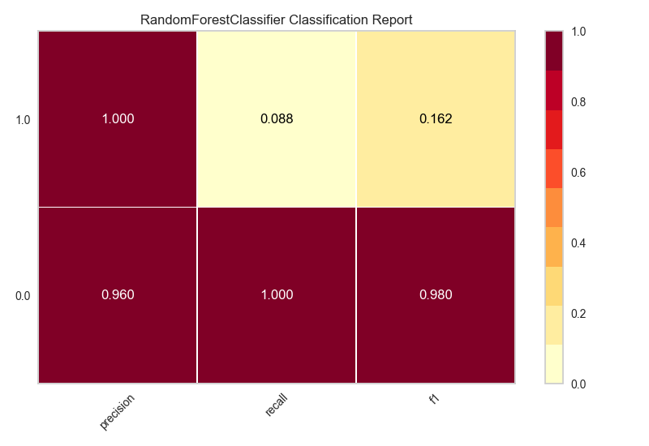
First Model

Slide 5
Enhancements to the initial models
Smote
Grid search result: criterion: 'gini', 'max_depth': 5, 'min_samples_split': 2
Re-smote with Grid search hyper-parameters
Feature set reduction to the top 50
Models tested
Random Forest
Logistic Regression
XGBoost

Slide 6
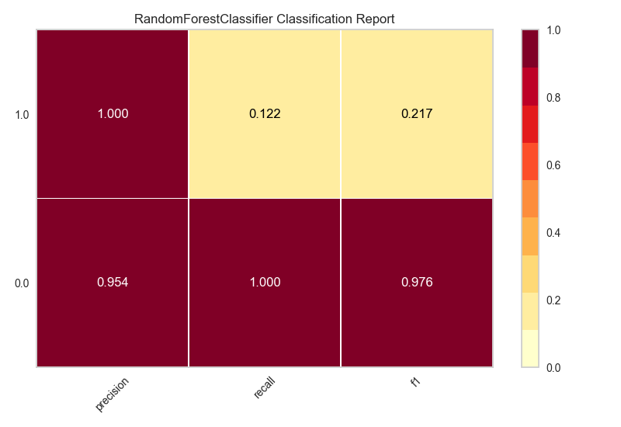
Random Forest with Smote & Grid Search hyperparameters

Slide 7
XG Boost
1.0
0.29
0.18
0.22
0.0
0.98
0.99
0.99
Precision
Recall
F1 score

Slide 8
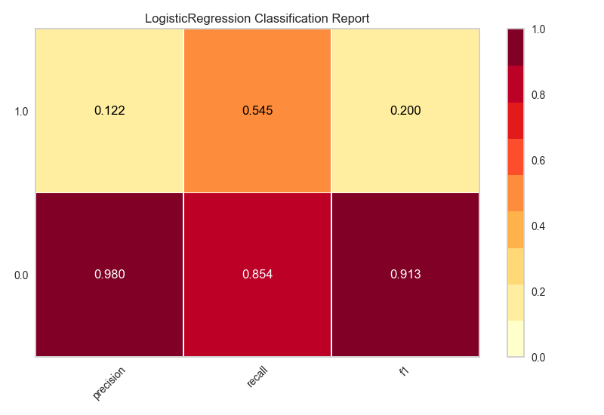
Logistic Regression

Slide 9
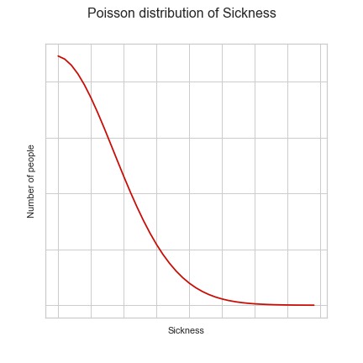
An Idea for Future Work
Predicting mortality should use a training sample of sick respondents and not a training sample of all respondents.
P(death | very sick) >> P(death | well)
Future Step
Use sickness as a continuous predictor and predict mortality probabilistically based on level of sickness
Very
Well
Deceased

Slide 10
Conclusion
With such an unbalanced class for deceased (< 2.5%) Smote only compensates so much
In future, consider using more years of data with differences for the same variable, respondent combination over time
In future, model respondents level of sickness as a predictor and oversample or subsample just the very sick respondents

